Slide 1


Shifting from TCC to LCC
Student-Centered Learning:
Relinquishing Control
Mr. Emad Halawa

Slide 2
Objectives :
Through out this presentation the attendants would:
- discuss the features of TCCs and LCCs and
how to judge his/her performance as a teacher.
- discuss the practicality of some suggested
techniques and strategies to change TCC to LCC.
- discuss some obstacles and how to overcome.

Slide 3
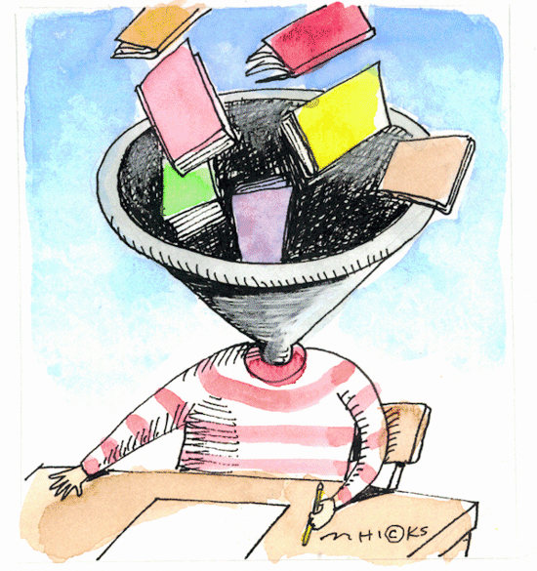
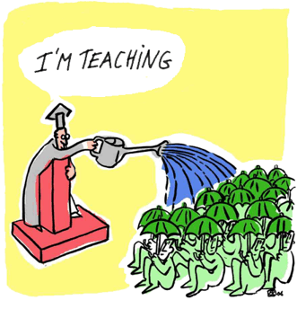
Discuss the following photos
“It is a rain of information”
Notes:
“In traditional schools, students learn not to ask too many questions, instead they learn to listen and repeat the expected answers. Students are the receivers of information, and the teacher is the dispenser. ” (http://thirteen.org/edonline/concept2class/inquiry/index.html)

Slide 4
“It is a rain of information”
“In traditional classes, students learn not to ask too many questions, instead they learn to listen and repeat the expected answers. Students are the receivers of information, and the teacher is the dispenser.
Notes:
“In traditional schools, students learn not to ask too many questions, instead they learn to listen and repeat the expected answers. Students are the receivers of information, and the teacher is the dispenser. ” (http://thirteen.org/edonline/concept2class/inquiry/index.html)

Slide 5

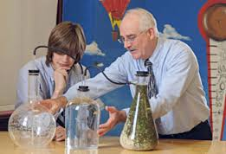
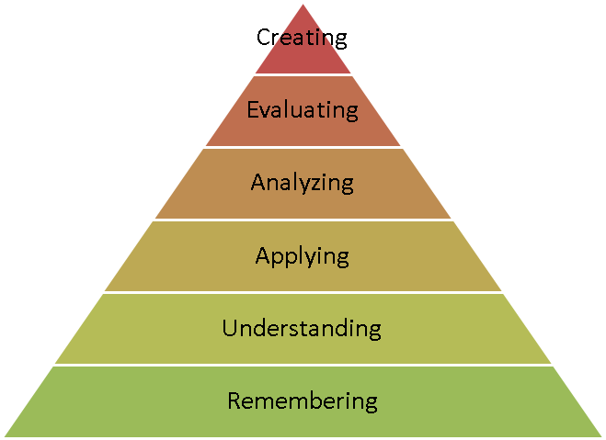
Some Current Trends
Movement toward:
Competency based versus knowledge-based education.
“Guide on the Side” versus “Sage on the Stage.”
Critical thinking versus specific content knowledge.

Slide 6
Newton’s First Law of Motion: The Law of Inertia
An object in motion continues in motion with the same speed and in the same direction unless another force acts upon it to slow it down or stop it.
An object at rest will remain at rest unless another force acts upon it to make it move.
Which kind of force do you want to be?

Slide 7

Changes Toward a Learner-Centered Classroom

Slide 8
Task 1

Slide 9
WHAT IS LEARNER-CENTRED LEARNING?
* Learner-centred learning puts more responsibility on
the learners for their own learning.
* It involves them in more decision-making processes,
and they learn by doing, rather than just by listening
and performing meaningless tasks which are often not
in context and therefore ‘unreal’ to them.
* learning becomes more active (rather than passively
listening to the teacher), it becomes more memorable.
* It is personalised, and relevant to the students’ own
lives and experiences, it brings language ‘alive’, and
makes it relevant to the real world.

Slide 10
Five Principles to Learner-Centered Approach (Weimer 2002)
Balance of Power:
  Give students power in making decisions and contributions to the course
The Function of Content:
  Don’t feel stressed to cover everything and remember, covering content and promoting learning are mutually reinforcing!!

Slide 11
Five Principles Continued
The Role of Teacher:
  Teachers would be “guides, gardeners, helpers” not just deliverers or organizers of information
The Responsibility for Learning:
  Is the student’s responsibility.
The Purpose and Processes of Evaluation:
  Should be more about how much they are learning than what grade they received.

Slide 12

Student Centered vs. Teacher Centered
How are they similar?
How are they different?
Notes:
r

Slide 13
Task 2

Slide 14
Differences

Slide 15


Teacher Centered
Focuses on procedure
Ex. V. To Be = am, is , are
“Present”
was, were “Past”
Abstract is shown, and process is memorized.
Student Centered
The focus in on the child’s thinking
Ex. Examples and situations are given to the students to aid in eliciting the rule.
Concrete, abstract, and pictorial.
Ex. Using videos or pictures if needed.

Slide 16



Teacher Centered
The teacher is the instructor and the decision maker
Ex. -Right and Wrong
Student Centered
The teacher is the facilitator and guide, and the students are the decision makers
Ex. -Student created
-Choices!

Slide 17


Teacher Centered
Pedagogy
– Based on Standards
-Curriculum centered
Student Centered
Pedagogy
- Based on Constructivism
– prior knowledge

Slide 18

Teacher Centered
Relies more on the textbook and direct instruction
Ex. Go to page 24 and answer the questions.
Student Centered
Highlights real life examples
Use situations that tie into the student’s lives that they can relate to and find interesting.
.

Slide 19
Teacher Centered
Rote knowledge
Student Centered
Experiential knowledge
Learning a procedure without truly understanding the material. For example memorizing the steps of solving a problem.
For example: Using problem solving methods and experimental ways of solving problems. The implementation of the student’s prior knowledge.

Slide 20
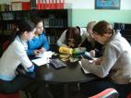

Teacher Centered
Isolated teaching and learning
Passive Learning
Ex. Students who know answers raise their hands, other are easily overlooked.
Student Centered
Collaboration
Active Learning
Ex. Children learn to take risks.

Slide 21
Teacher Centered
Learning takes place only in the classroom
Student Centered
Learning extends beyond the classroom
- Students are able to relate problems and strategies to their lives.

Slide 22
Similarities

Slide 23
* The objective is to teach the child to understand the concept!
* The teacher corrects the child when he or she is incorrect.
* The teacher is present to overlook the child’s work, and help guide the child in the right direction.

Slide 24
Tactics For LCCs ( I )
Ask don’t tell: always try to elicit information, ideas, and answers from the students.
Focus on students’ experience and interests: use the
course book as a base for then moving on to practice activities relating to the students' personal lives and
areas of interest and experience (personalization)
Communication over accuracy: the main reason for
students learning a language is to be able to
communicate with other speakers of that language

Slide 25
Tactics For LCCs ( II )
Learning by doing: the more actively involved students
are in their own learning, the more they are likely to remember what they learn.
Students have choices and make decisions about
learning. Group work requires negotiation and decision making – working together towards a common goal.
Focus on confidence building for real-world skills.

Slide 26
Tactics For LCCs ( III )
Encourage interest in English used in the real world.
By using authentic materials familiar to the students (magazines, Internet, video, television, letters.. etc.), students are constantly in touch with the language in an absorbing way.
Tasks are open-ended. Open-ended tasks are wider
in their focus and involve a variety of language skills.
High exposure to English through the use of authentic materials again: students may be set homework
involving research undertaken using the internet or
other English language reference sources.

Slide 27
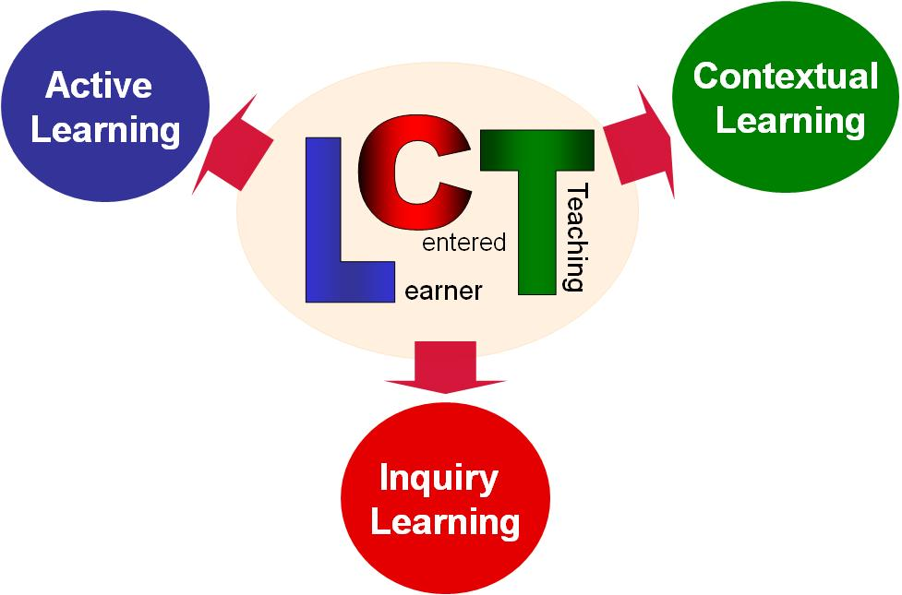
LCT Approaches

Slide 28
Relinquishing Control: The Process is the Product
  Not:
    Something completely new.
    Simply relinquishing the role of lecturer.
    Compromising the educational experience.
  Rather:
    Creating active learning opportunities.
    Becoming more student-centered in your teaching approach.
    Creating a semiautonomous classroom.

Slide 29

Why Do It?
The active learning approach:
  Forces students to think about
  themselves as learners.
  Is more about knowledge and skills (intrinsic) and less about tests/grades (extrinsic).
  Encourages students to be producers of knowledge rather than just information consumers/containers.
  Prepares student for 21st century challenges.

Slide 30
Why Does it Work?
Empowers students.
Forces students to think about themselves as learners.
Creates independence and ownership of learning.
Fosters collaborative learning.
Encourages creativity.
Creates a rich learning environment inside and outside the classroom.
Fosters new skills – problem solving, critical thinking, etc.

Slide 31
Some Results
Students learn to ask questions, not just repeat back answers.
Students become active learners, rather than passive learners.
Students build confidence.
Students prepare for 21st century challenges with 21st century skills.
Express
Engage
Question
Collaborate
Experience
Discuss
Compare-Contrast
Debate
Adapt
Create
Synthesize

Slide 32


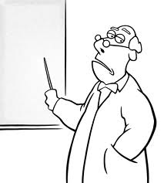
Some “yes-buts”
“We have so much to cover!”
“They won’t do the work; they expect me to lecture!”
“I’m the expert on this, not the students.”
Others?

Slide 33

How to Do It
Find out who students are and what they expect
  What they want to learn.
  What questions they have.
Use project-based learning.
  Employ teams.
  Assign roles.
Let students choose some topics/sequences of material.
Create rubrics – and have students create theirs.
Introduce learning contracts (especially with teamwork).
Encourage self-assessment.

Slide 34
Now … Let’s Do It!
Break into groups of three.
Plan four ways to teach students about personal hygiene.
  Lecture (I’m telling you)
  Demonstration (I’m showing you)
  Application (you do it)
  Discovery (you figure it out)
Choose a topic from one of your courses – and try it again.

Slide 35


How Do We Assess the Learning?
Hard measures:
  Comparison of learning using different teaching methods (Teaching as Research: TAR).
  Standardized tests.
Soft measures:
  Attendance.
  Energy in the room.
  Student satisfaction.
  Teacher evaluations.
  Teacher satisfaction.

Slide 36


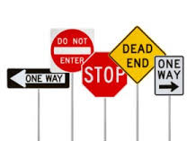
Task 3
  What fears do you have?
  What’s worked for you?
  What barriers do you anticipate?

Slide 37

Challenges
Still need to maintain quality and set high expectations.
Still need teaching plan – and need to stick to it.
  - but need to be flexible and allow some “wiggle room.”
Need to prepare students for the new active model.

Slide 38

Still …
It can be messy at first.
It is not linear, it is complex.
It can be uncomfortable.
It takes resilience to effect change.
The winding road gets you to the top of the mountain!

Slide 39
Sources
Sources:
Mallinger, M. "Maintaining Control in the Classroom by Giving Up Control Maintenir Le Contrôle De La Classe Par l'Abandon Du Contrôle]." Journal of management education (Newbury Park, Calif.) 22.4 (1998)ProQuest. Web. 3 Sep. 2013.
AbstractAlthough collaborative learning models are used by numerous faculty members, many instructors are concerned that giving up control in the classroom means com-promising the educational experience. Empowering students, however, requires more of the instructor than just relinquishing the role of lecturer. This article offers a set of frameworks to help faculty create a semiautonomous classroom and, at the same time, protect against loss of quality control. Cross-cultural implications of collaborative learning are all addressed
On Relinquishing Control in the Classroom (and Life)
  http://alisonlentz.blogspot.com/2012/04/on-relinquishing-control-in-classroom.html?m=1
How We Started Relinquishing Control
  http://relinquishingcontrol.wikispaces.com/Start+with+the+Basics
Classroom Innovation Means Giving Up Control: The essence of what drives innovation begins with what kids want to learn.
  http://www.cea-ace.ca/blog/donna-fry/2012/12/5/classroom-innovation-means-giving-control
Relinquishing Control
  http://edtechideas.com/2010/11/24/relinquishing-control/
Don’t give up on relinquishing control to your students
  http://educatedtodeath.com/post/12164495790/0022-dont-give-up-on-relinquishing-control-to-your
Student-Centered Classroom Culture (PDF)
  http://www.intel.com/content/dam/www/program/education/us/en/documents/assessing-projects/overview-and-benefits/student-centered-classroom-culture.pdf

