Slide 1


State of Kuwait
Ministry of Education
Hawally Educational Area
E
xpertise
nlightement
Gamification in Education
The Theory and Application
Presented by..
H.O.D : Mariam Mendakar
E.L.T Supervisor : Eman Ashour

Slide 2



Caution….
Silence your cell phones
Stay positive
Ask whatever you want to

Slide 3
The Agenda..
1. The history of Gamification
2. Gamification…The definition
3. Characteristics of Gamification
4. Assumption 1
5. Educative and mis-educative
Why Gamification?
Assumption 2
The 3 Fs
9. The conclusion

Slide 4

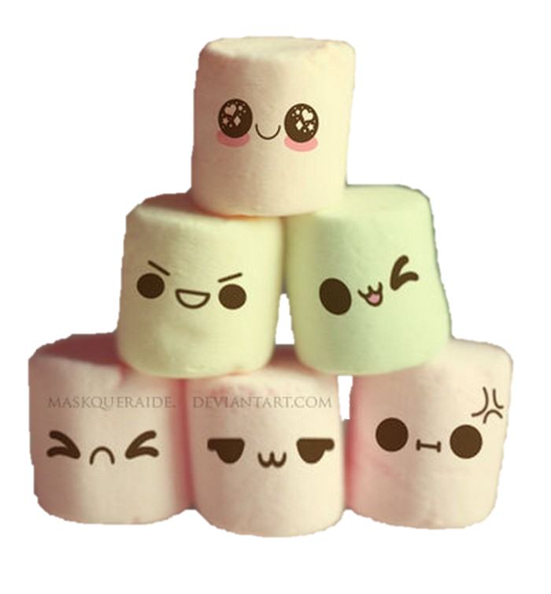
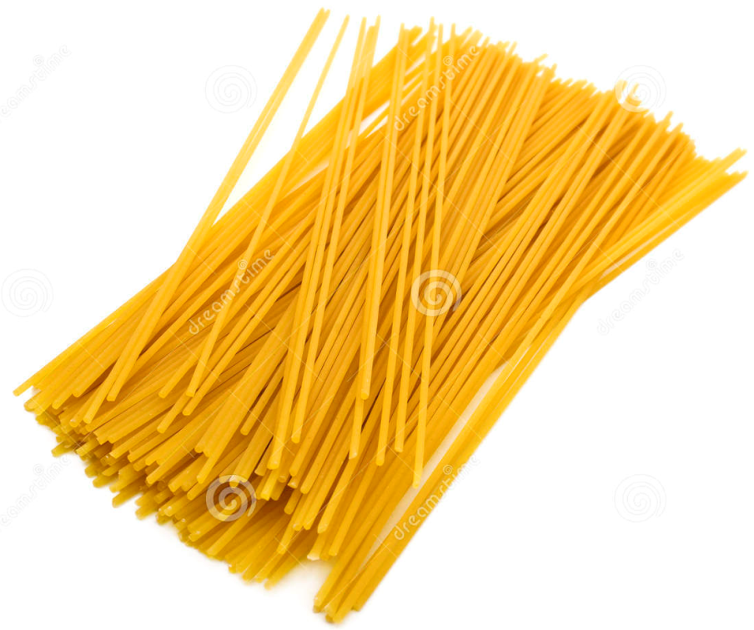
Task 1
The food challenge

Slide 5

The history of Gamification

Slide 6


Slide 7
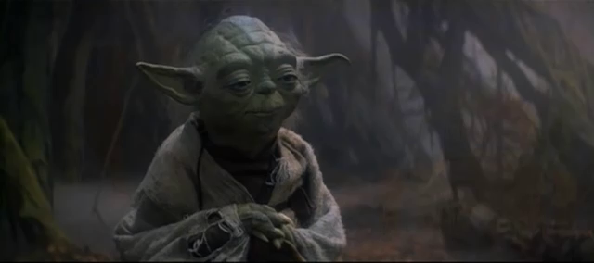
A wise man saying

Slide 8

Task 2
Origami

Slide 9
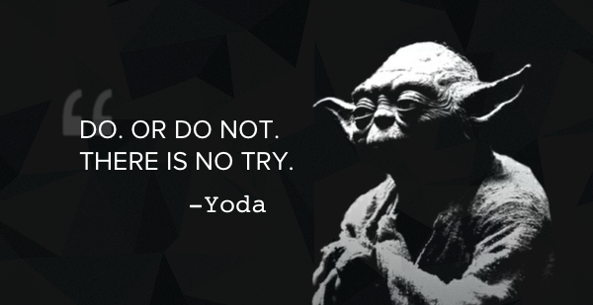
AGREE ?
DISAGREE?

Slide 10

Gamification !
GAMIFICATION is a bizarre word. What does it mean? How does it matter? How can it be related to learning? The only people we don’t have to explain it to are kids. They get it. They got it. They are part of it. Simply, when a boy gives hid brother 10 points for getting him a soda. That`s GAMIFICATION. When a boy times himself to see how quickly he can say the definition of the word (economic) as a study technique, That`s GAMIFICATION. When a boy sits down to learn Algebra in a game, That`s GAMIFICATION.

Slide 11
On its surface, GAMIFICATION is simply, the use of games to make learning and instruction more fun. Underneath the surface is the idea of engagement. GAMES are important in gamification. They give learning and experiences meaning, provide a set of boundries within a safe environment to discover, think and try things out. Games provide motivation to succeed and reduce the sting of failure. Games are the ideal learning environment with their built in permission to fail, encouragement of out of box thinking and sense of control.
We need GAMIFICATION to avoid the endless of uninspiring experiences.

Slide 12
SO,
The GAMIFICATION is an educational approach to motivate students to learn by using games in learning environments. The goal is to maximize enjoyment and engagement through capturing the interest of learners and inspiring them to continue learning.
The use of GAMES to enhance NON-GAME context.

Slide 13

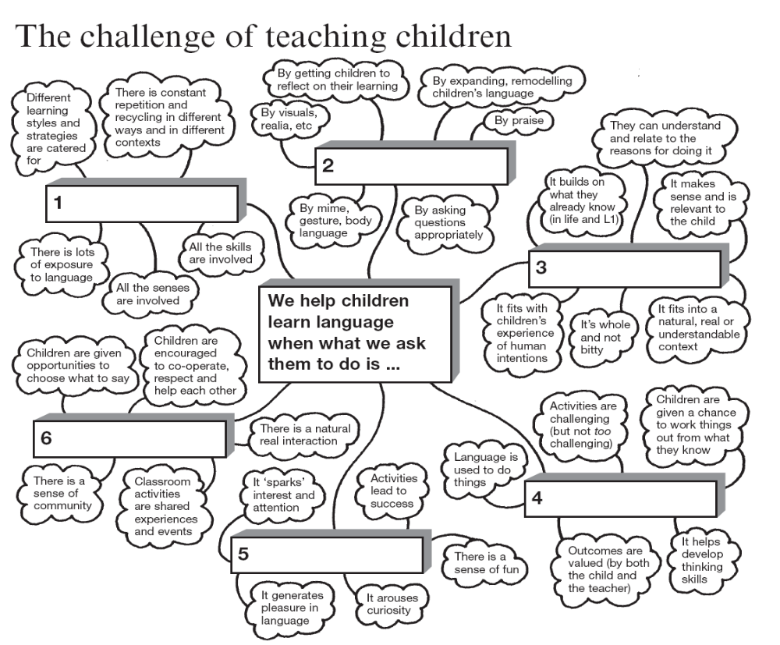
Use the words to fill in the boxes
Enjoyable
Full of Practice
Meaningful
Purposeful
Social
Supported

Slide 14
Characteristics of Gamification
enjoyable
achievement
Purposeful
challenging
Educative
Risk-taking
Problem-solving
Feedback
Meaningful
Persistence
Motivating
engagement

Slide 15
Assumption 1 :
All activities and games
are educative…
FALSE

Slide 16
When educative ?
When mis-educative?
Not all experiences are equally educative.
Mis-educative experience : the experiences that is harmful to others and has the effect of arresting the growth of further experience in the future. The experience may be enjoyable and yet promote a careless attitude.
Educative experience: is a growth that allows for further growth. It expands the learner`s opportunities for learning and growth in the future.

Slide 17

Unleash your inner artist and let your imagination fly
Task 2:

Slide 18
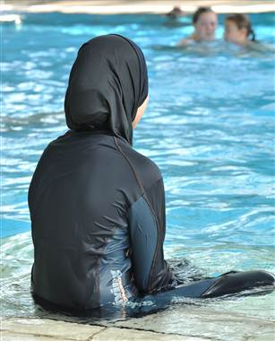
How can learning be mis-educative ?!

Slide 19
The case :
There are 4 million muslims living in Germany, which has led German government and school officials to look for ways to integrate German-Muslims into communities, while still respecting their religious beliefs. The most recent case has centered on required swimming lessons in German schools and has received a fair amount of international media attention. At the heart of the buzz is a German court's ruling that Muslim girls must take part in co-educational swimming lessons as part of their educational experience, but will be allowed to wear burqinis(swimwear for Muslim women). The modesty issue has largely been addressed through allowing Muslim girls to wear burqinis. However, the plaintiff in the case, a Muslim teenage girl and her parents, claim that requiring her to participate in swim classes with other young men runs counter to their religious beliefs and practices.

Slide 20
Mis-educative experience
By forcing Muslim girls to swim, they will ensure that these girls will swim for the few hours a week they are required (during the few months when they are in the class). But, this forced participation is also likely to turn Muslim girls off to swimming in the future. And, in that way, this will become a miseducative experience because it is likely to inhibit these students' learning and growth as future swimmers. In this case, the court has forgotten that the swimming lessons offered in schools are the means to an end.

Slide 21

Whisper….
Don`t force your pupils to take part in the activity. They will feel disappointed, alienated and disengaging.
Always find another solutions and alternatives to get them involved with their classmates.
Remember , the experience you provide will grow with them and shape their personality.
So, we aim to …

Slide 22
A Japanese ship leaves everyday
Think Twice…

Slide 23

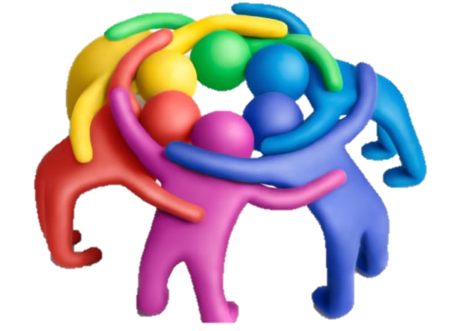
Task 3 ….
Change into verbs

Slide 24
Serve
Service ……………
Shop ……………
Supply …………....
Slave …………….
Large ……………
Omission ……………
Computer ……………
Proposal ……………
Modern .…………...
Effect ……………
Half ……………
Breath ……………
Simple ……………
Game …………...
shop
supply
enslave
enlarge
omit
compute
propose
modernize
affect
halve
breathe
simplify
gamify

Slide 25
Why do we GAMIFY ?
Immediate feedback for actions.
A sense of accomplishment.
giving students ownership of their learning.
opportunities for identity work through taking on alternate selves.
freedom to fail and try again without negative repercussions.
chances to increase fun and joy in the classroom.
making learning visible
providing a manageable set of subtasks and tasks
inspiring students to discover many motivators for learning

Slide 26



Let`s GAMIFY ?
Task 4 ….

Slide 27


Task
The word chain

Slide 28
Assumption 2 :
Enjoyment is ENOUGH
FALSE

Slide 29
enjoyment is not enough
Enjoyment itself is not enough to make an experience educational and gamified. A teacher should take this into consideration when planning "fun" activities. The value of an experience is linked to the effect it has on an individuals present, future, and the extent to which it allows them to actively contribute to society.
Enjoyment is not enough. Other elements should be considered. ( engagement, feedback, challenge and socializing)

Slide 30
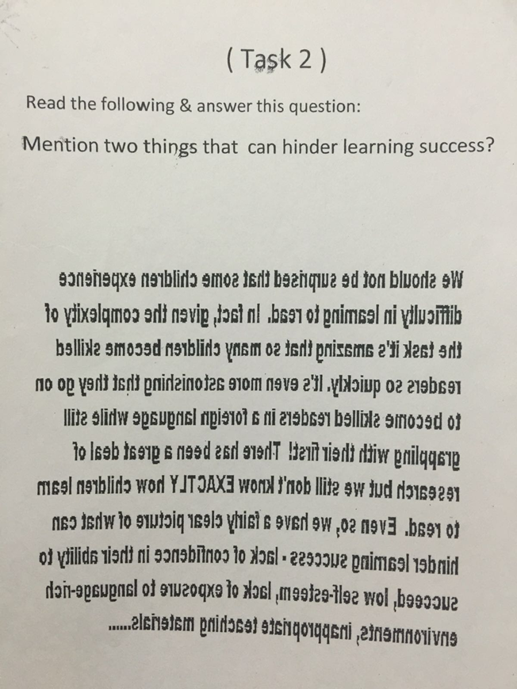
Task

Slide 31

Gamification = Three Fs.
F
F
F

Slide 32
The 3 Fs of Gamification
FEEDBACK
FRIENDS
Fun

Slide 33

The conclusion…
Learning should be fun. By integrating imagination, creativity and game mechanics with the desired information, knowledge can come to life in meaningful ways. Compared to traditional systems, this offers a far more effective way to inspiration, accomplishment, Creativity & Feedback.
Gamified environments create new social and cultural worlds - worlds that help us learn by integrating thinking, social interaction, and technology, all in service of doing things we care about, Which creates an interactive learning environment where engagement is key to success.

Slide 34
The End

